Slide 1
6 Sigma Assignment
Contents
1. Define
2. Measure
3. Analyze
4. Improvement
5. Control
2026.Sep.23
6 Sigma GB assignment
IVI LD – Nguyen Duc Long
Notes:
1

Slide 2
Six Sigma Project Register
Team | IVI LD
Leader | Nguyen Dinh Huong TL
Owner | Nguyen Duc Long
Task category
□ HW □ SW
□ Mecha ■ Current job
Theme | Reduce defect rate of Model Porsche CID J1 Dual Luminance |  |  |  | Period | 2026.Mar.09 ~ 2026.Jul.03 |  |  | Task team name | Inspection Engineering Project
Six Sigma Project |  | Improvement Goal (Stretch Goal) |  |  |  |  |  |  | Idea of breaking the limit
 |  | Improvement index |  | Current |  | World Best | World Best | Goal
Improve Luminance value |  | KPI | Defect rate (ppm) | 226,624ppm |  | N/A | N/A | 0 ppm | Teaching robot and change camera angle for detecting the central of PID Make check sheet to control camera equipment
 |  | ProjectY | Luminance (800-2000Cd/m²) | 788 Cd/m² Cpk= 0.15 |  | N/A | N/A | 909 Cd/m² Cpk ≥1.33
Management Issue (Biz. Issue) |  | Implement Plan (Fast & Strong) |  |  |  |  |  |  | Task Member
-Luminance issue is affected to UPH of line, loss time when issue happen. -NG LCD of this issue after retest NG, can not pass inspection station, NG LCD will be returned to HEESUNG supplier scrap, lead to IF cost, so it is necessary to find action to eliminate this issue, improve factory performance
 |  |  |  |  |  |  |  |  | Location
 |  |  |  |  |  |  |  |  | LG Electronics Viet Nam-Hai Phong
Qualitative Performance |  | Quantitative Performance |  |  |  |  |  |  | Neck Point
Improving smoothly testing process for sets Reducing cost |  | 1 LCD part =118.72$ The scrap cost of Luminance issue on March: 19*118.72 = 2255.68$ → Need improve to reduce the scrap cost of Luminance issue |  |  |  |  |  |  | Because improvement action related to equipment, So need support from PE team
❑ Schedule
3/9
4/1
5/1
5/19
6/15
Team | Name | Role
IVI LD | Nguyen Duc Long | Task leader
 | Hoang Nhan Quoc | Member
IVI PE | Pham Van Hung | Member
IVI PM | Ta Van Cong | Member
D
M
A
I
C
Key activity / Output
D : Define issue, define defect rate, collect defective sample and issue information
M : Gage R&R evaluate equipment
A : Use 5 Why analysis method to find root cause. Test sample using different setting and pallet
I : Meeting with HQ IE discuss about improvement action. Make improvement action plan and follow up
C : Control defect rate of Luminance issue through GMES system
Notes:
Define: 2 weeks
Measure: 4 weeks
Analyze: 2 weeks
Improve: 4 weeks
Control: 2 weeks
2

Slide 3

1.1 Define issue
Project name
- Improve Luminance value
Purpose
- Improve illuminance station performance → improve Luminance value from below 800 Cd/m2 to 800-2000 Cd/m²
Outline
- If Luminance measure issue is still happening and pending at illuminance station which leads to line loss time and failure to meet line UPH.
- The delay of checking issue will result in a remain manufacture of line IVI5. Also the NG LCD sent back to supplier to retest, scrap which lead to more scrap cost.
→ To prevent this in advance, we selected this topic as Six Sigma GB task to improve luminance output performance from mass production stage and reduce to the minimum the cost for factory with this topic.

Slide 4

1.2 Yy break down
Big Y
Little y1
Little y2
Little y3
Activity
PIC
Reduce Porsche CID Defect rate
Machine defect
Illuminance Function
Luminance value
6 Sigma assignment
IVI LD IE
2294 PPM
(xx/xxxEA
Jun~Aug Y26)
56.3% 1292 PPM
45.4% 576 PPM
39.8% 505 PPM
Haptic/Touch
Function
Calculate contrast value
Real defect _ Material
Return to supplier
HEESUNG vendor
10.9% 140 PPM
5.6% 71 PPM
Hardware defect
Power Function
Initial/ Booting
Broken pin connector _ check PCBA
Mr. Hai HW
7.8% 178 PPM
Software defect
Uniformity Function
Black Uniformity value
Improve software
HQ R&D
Before
35.9% 824 PPM
2294 PPM
After
1381 PPM
Decrease defect rate of Porsche CID
Most of Hardware issue cause by foreign material inside the set after assembly process, SQA circuit, LCD from supplier, need to improve by HW members.
Software issue will be solved by HQ software members.
Machine include issue from inspection item, Luminance is important item measured by machine, it refers to the amount of light emitted from the display per unit area, it affects the brightness and visibility of the screen, that’s why I choose this issue for my 6 sigma assignment.

Slide 5

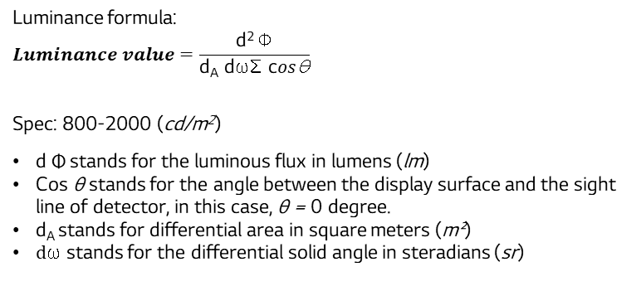
1.3 Define Project Y
To reduce the luminance test value NG, Project Y is formed :“Luminance value "
What is Luminance ?
Project Y
Luminance value is a term in the field of imaging and light source of LCD.
Luminance can be used to show how well a screen performs
such as brightness level, Contrast, Color accuracy, Viewing Angles.
The project was selected as “Luminance value" of the Porsche CID J1 Dual model.
Luminance formula:
$$Luminance value=\frac{\text{d}\text{2} \text{Φ}}{\text{d}\text{A} \text{d}\text{ω}\text{Σ} \text{c}os\text{θ}}$$
Spec: 800-2000 (cd/m²)
$\text{d} \text{Φ}$stands for the luminous flux in lumens (lm)
Cos θ stands for the angle between the display surface and the sight line of detector, in this case, θ = 0 degree.
$\text{d}\text{A}$ stands for differential area in square meters (m²)
$d\text{ω}$ stands for the differential solid angle in steradians (sr)
PID
CID
+
J1 Dual PPR RHD set
Camera
CS2000
The sensors inside the detector will have the task of receiving the luminance value at the central of LCD, then calculating and respond to program the Luminance value measurement result.
Method measure:
The set screen connected to bench, when program send the request for display perform at the highest brightness level
The J1 Display shows up the White screen with maximum brightness
Detector CS2000 move to the central of PID LCD and the sensor recognize the central of display and measure Luminance level.
Because the central always have the better brightness than the corner and edges, detector must be right place to measure the best value.
The result will be recorded and send back to the program.
Issue: The Luminance values ​​measured at the PID screen is lower than the average compared value. This leads to a Luminance values test under spec.
Project Y= Luminance value = f(x1,x2,..x5) + e

Slide 6



2.1 Gage R&R outline
Measure
Define
Analyze
Improve
Control
Equipment information:
Equipment:
- Power supply, Pallet
- CID bench
- CANSIM
- LMK camera CS2000
- Resolution: 0.01 Cd/m²
Program: LG Moohantech
Function test Luminance station
Checking brightness level
Detect and measure Luminance value
Test set without can mode
Checking pattern CID black, white
Calculate contrast
Illuminance station diagram
LMK Camera CS2000
Notes:
Output level resolution: 0.01 dB

Slide 7
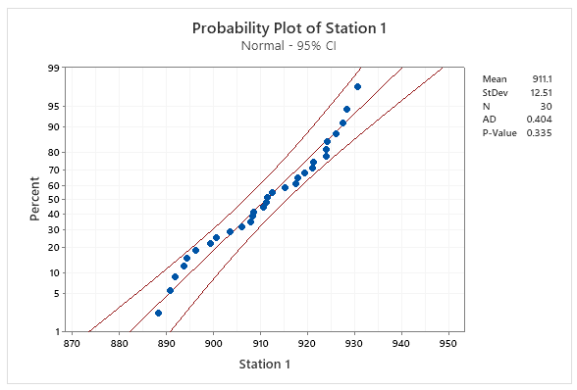
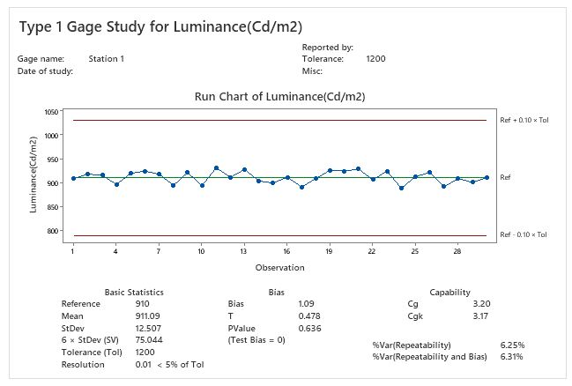
2.2 Type 1 Study
Measure
Define
Analyze
Improve
Control
Station 1 Luminance
I choose gage study type 1 to assess the ability of component to measure based on repeatability and bias of the instrument.
In this case, choose 1 sample and repeated test for 30 times.
H0: Bias = 0 in measurement system.
H1: Bias ≠ 0 in measurement system.
No | Luminance(Cd/m²) | No | Luminance(Cd/m²)
1 | 908.00 | 16 | 911.46
2 | 917.93 | 17 | 890.79
3 | 915.27 | 18 | 908.47
4 | 896.15 | 19 | 926.02
5 | 919.40 | 20 | 924.05
6 | 924.00 | 21 | 928.50
7 | 917.44 | 22 | 906.05
8 | 894.39 | 23 | 924.20
9 | 921.04 | 24 | 888.30
10 | 893.60 | 25 | 912.50
11 | 930.70 | 26 | 921.38
12 | 911.27 | 27 | 891.90
13 | 927.62 | 28 | 908.25
14 | 903.52 | 29 | 900.60
15 | 899.24 | 30 | 910.68
Spec: 800.00 ~ 2000.00
Reference value: 910 (golden sample)
Resolution of Instrument: 0.01
Conclusion
P value=0.636 > 0.05 Fail to reject H0 Bias=0 (PASS)
Cg=3.20 (Std>1.33) PASS | Cgk=3.17 (Std>1.33) PASS
%Var(Repeatability)=6.25% (<10%) PASS
%Var(Repeat.+Bias)=6.31% (<10%) PASS
Resolution=0.01 < 5% of Tolerance
Notes:
Step1: Check tolerance range to assess the variation in measurement system (measurements fall within the ± 10% tolerance range, is capable)
Step2: Check P value to assess the bias (P value, a)
Step3: Check cg, cgk to assess the capability of measurement system (benchmark value)
Cg: Gage Capability : Measures the ability of the measurement device to detect variation in the product
Cgk: Gage Capability Index : Measures the ability of the measurement device to detect variation in the product, but also considers the position of the measurement range relative to the control limits

Slide 8
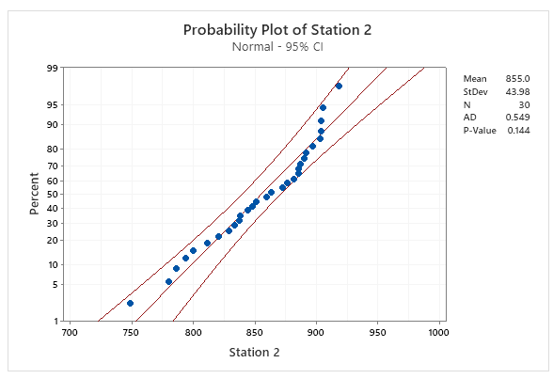

2.2 Type 1 Study
Measure
Define
Analyze
Improve
Control
Station 2 Luminance
I choose gage study type 1 to assess the ability of component to measure based on repeatability and bias of the instrument.
In this case, choose 1 sample and repeated test for 30 times.
H0: Bias = 0 in measurement system.
H1: Bias ≠ 0 in measurement system.
No | Luminance(Cd/m²) | No | Luminance(Cd/m²)
1 | 779.90 | 16 | 872.50
2 | 811.25 | 17 | 881.38
3 | 794.00 | 18 | 820.60
4 | 829.24 | 19 | 905.68
5 | 887.44 | 20 | 897.04
6 | 844.39 | 21 | 833.60
7 | 851.46 | 22 | 885.70
8 | 799.79 | 23 | 838.27
9 | 903.47 | 24 | 837.62
10 | 876.02 | 25 | 863.52
11 | 904.05 | 26 | 892.00
12 | 918.50 | 27 | 847.93
13 | 890.05 | 28 | 885.27
14 | 904.20 | 29 | 786.15
15 | 748.30 | 30 | 859.40
Spec: 800.00 ~ 2000.00
Reference value: 910 (golden sample)
Resolution of Instrument: 0.01
Conclusion
P value=0.00 <= 0.05 Reject H0 Bias!=0 (FAIL)
Cg=0.93 (Std>1.33) FAIL | Cgk=0.54 (Std>1.33) FAIL
%Var(Repeatability)=21.46% (>10%) FAIL
%Var(Repeat.+Bias)=37.17% (>10%) FAIL
Equipment has problem. Cannot measure parts consistently. Need to improve measurement system.
08 / 33
Notes:
Step1: Check tolerance range to assess the variation in measurement system (measurements fall within the ± 10% tolerance range)
Step2: Check P value to assess the bias (P value, a)
Step3: Check cg, cgk to assess the capability of measurement system (benchmark value)
Cg: Gage Capability : Measures the ability of the measurement device to detect variation in the product
Cgk: Gage Capability Index : Measures the ability of the measurement device to detect variation in the product, but also considers the position of the measurement range relative to the control limits

Slide 9
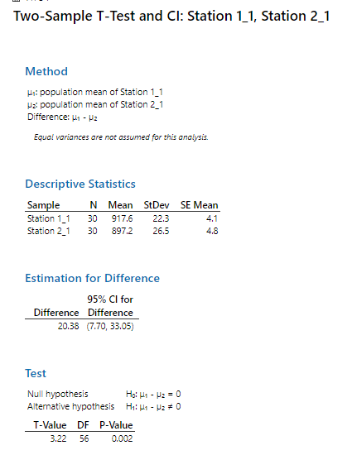
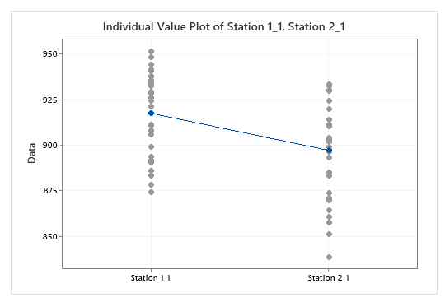
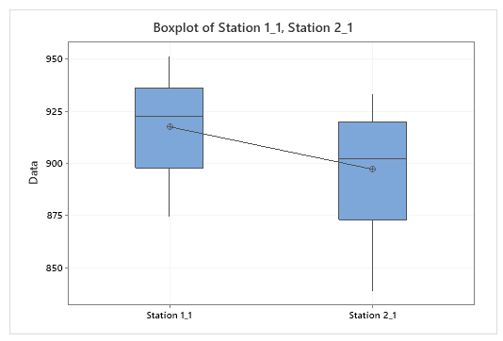
2.3 2 sample T-test for station 1 and 2
Measure
Define
Analyze
Improve
Control
After check Type 1 study, Comparing among 2 stations of Luminance process.
Spec: 800- 2000 Cd/m²
Station 1 | Station 2
891.90 | 864.43
908.25 | 902.75
940.60 | 924.61
910.68 | 893.10
921.04 | 910.28
893.60 | 885.34
935.70 | 896.79
951.27 | 911.49
937.62 | 930.12
883.52 | 873.72
908.00 | 933.11
937.93 | 899.03
935.27 | 929.61
886.15 | 857.73
929.40 | 919.88
934.00 | 913.82
899.24 | 871.07
917.44 | 903.96
874.39 | 851.55
911.46 | 883.16
890.79 | 860.89
948.47 | 903.74
926.02 | 896.62
944.05 | 932.64
928.50 | 933.35
906.05 | 901.82
924.20 | 838.91
878.30 | 869.70
932.50 | 903.21
941.38 | 919.98
Conclusion : we chose 30 samples and tested at 2 stations.
H0: there is no significant difference between station 1 and station 2
H1: there is a significant difference between station 1 and station 2
P value = 0.002 ≤ 0.05 → reject H0,
→ The charts also showed that measurement value have different between station1 and station 2. So need to check why there is difference.

Slide 10


2.4 Type 3 Study
Measure
Define
Analyze
Improve
Control
Station 2 Luminance
Need to evaluate repeatability and reproducibility.
Because the Luminance station is fully automated with no operator influence, Type 3 Gage Study is used to evaluate equipment repeatability.
In type 3 study, use 25 samples to verify station, each sample is measured repeat 2 times.
Spec: 800- 2000 (Cd/m2)
No | Data | No | Data
1 | 796.95 | 13 | 837.73
1 | 786.61 | 14 | 811.78
2 | 794.73 | 14 | 833.46
2 | 796.58 | 15 | 836.42
3 | 838.61 | 15 | 837.85
3 | 839.58 | 16 | 817.70
4 | 810.76 | 16 | 857.9
4 | 830.05 | 17 | 837.17
5 | 815.12 | 17 | 838.29
5 | 835.75 | 18 | 828.88
6 | 823.98 | 18 | 826.94
6 | 834.57 | 19 | 840.14
7 | 827.40 | 19 | 839.72
7 | 827.69 | 20 | 830.75
8 | 839.12 | 20 | 830.78
8 | 835.42 | 21 | 823.24
9 | 839.73 | 21 | 826.32
9 | 842.06 | 22 | 825.35
10 | 834.01 | 22 | 827.79
10 | 834.48 | 23 | 838.87
11 | 834.67 | 23 | 837.29
11 | 836.61 | 24 | 850.33
12 | 786.15 | 24 | 819.42
12 | 780.77 | 25 | 755.89
13 | 827.29 | 25 | 853.94
% Contribution of Gage R&R = 71.56% > 10% →NG
% Study Var = 84.59% >10% → NG
% Tolerance = 8.33 < 10% → OK
NDC: 1 < 5 → NG
Conclusion: GR&R Contribution=71.56% (>10% NG), Study Var=84.59% (NG), Tolerance=8.33% (OK), NDC=1 (<5 NG). System is NOT acceptable. Requires immediate improvement.
Notes:
H0: The group mean is equal
H1: The group mean is not equal
Follow AIAG guidelines, if the measurement system variation is less than 10% of the process variation, then the measurement system is acceptable. Because the %Study Var, the %Tolerance, and the %Process are all less than 10%, the measurement system is Good
NDC: number of distinct categories: khả năng phân biệt của hệ thống đo

Slide 11


3.1 Find the Root Cause that making measurement system have problems
Analyze
Define
Measure
Improve
Control
After checking by type 1, we see that measurement system of station 2 have problems, I use logic tree to find the root cause
Power supply
Power supply is stable
Power supply is not affected
Machine
Pallet
All model used same kind of pallet
Changing pallet no different
Camera equipment (CS2000)
Measure incorrectly

Change new camera
Logic tree analysis
Camera Angle is changed
Change angle of camera

Luminance at Station 2
CANSIM
CANSIM send weak signal for LCD recognize
Change new CANSIM

Material
Set
Return LCD and check on vendor → result is OK
LCD is not affected
Method
Sequence test, timing
Sequence is used for all model, but only this model have issue
Sequence is not affected
Plug in set to pallet not fully
Other function is OK, only Luminance is NG
Not relate to set plugging in
Man
Working skill
Automatic process
Man is not related

: Potential factor

Slide 12
3.1 Find the root cause that making measurement system have problems
Analyze
Define
Measure
Improve
Control
2 Samples T
No | Potential Factors | List checking | Station | Tool to identify
1 | CAN SIM send weak signal to LCD recognized | Checking luminance value before /after change to new CAN SIM | Station 2 | 2 sample T
2 | Measure incorrectly | Checking luminance value before /after change to new camera | Station 2 | 2 sample T
3 | Camera angle changed | Checking luminance value before /after changing angle of detector | Station 2 | 2 sample T

: Potential factor

Slide 13



3.1 Find the root cause that making measurement system have problems
Analyze
Define
Measure
Improve
Control
2 Samples T _ Analysis
Detection Luminance from CANSIM of Station 2_Change to the new CANSIM
H0: The changing CANSIM does not affect in the luminance in station 2
H1: Changing the CANSIM affects the luminance in station 2
P-value = 0.695 > 0.05 -> Fail to reject H0 (No significant difference before/after changing CANSIM).
Changing CANSIM has no significant effect on luminance (Factor eliminated).

Slide 14



3.1 Find the root cause that making measurement system have problems
Analyze
Define
Measure
Improve
Control
2 Samples T _ Analysis
Detection Luminance from Camera of Station 2_Change to the new camera
H0: The changing new camera does not affect in the luminance in station 2
H1: Changing the new camera affects luminance in station 2
Since the P-Value before and after changing to the new camera is not normally distributed, Mann-Whitney test was used
P-value = 0.950 > 0.05 -> Fail to reject H0 (No significant difference before/after changing camera).
Changing camera has no significant effect on luminance (Factor eliminated).

Slide 15



3.1 Find the root cause that making measurement system have problems
Analyze
Define
Measure
Improve
Control
2 Samples T _ Analysis
Detection Luminance from Camera of Station 2_Change to the angle of Camera
H0: The changing angle does not affect in the luminance in station 2
H1: Changing angle affects the luminance in station 2
P-value = 0.000 < 0.05 -> Reject H0 (Significant difference before/after angle adjustment).
Changing camera angle significantly affects luminance -> Root Cause verified!

: Potential factor

Slide 16
3.1 Find the root cause that making measurement system have problems
Analyze
Define
Measure
Improve
Control
2 Samples T
No | Potential Factors | List checking | Station | Tool to identify | P value | Conclusion
1 | CAN SIM send weak signal to LCD recognized | Checking luminance value before /after change to new CAN SIM | Station 2 | 2 sample T | 0.695
2 | Measure incorrectly | Checking luminance value before /after change to new camera | Station 2 | 2 sample T | 0.950
3 | Camera angle changed | Checking luminance value before /after changing angle of detector | Station 2 | 2 sample T | < 0.001 | Root Cause (Significant effect, P < 0.05)


: Potential factor

Slide 17



3.1 Find the root cause that making measurement system have problems
Analyze
Define
Measure
Improve
Control
Problem
Cause
Improvement
Progress Monitoring
Issue: ISSUE NG PPM LUMINANCE
Defect date: February -2024
Model: CID10RT-PJD.BEU1PAF
Station: Luminance
Q’ty : 21ea/682ppm
Root Cause
1. Why does the issue occur?
Because Luminance of set was measured with value under spec
(Spec : 800 – 2000 Cd/m2)
2. Why was Luminance of set value under spec ?
Because LCD center point is not matching with Camera Angle view.
3. Why lead to issue?
Camera Angle view is changed when the line production in long time so there is different about luminance value between Camera angle view at perpendicular and other angle (Luminance measurement based on camera position in line)
4. Why did the camera angle change?
Because the J1 Dual model requires camera movement between PID and CID screens. After long production time, mechanical vibration causes gradual angle deviation from 90° standard.
5. Why was there no prevention mechanism?
Because there was no periodic check sheet or master sample verification procedure to monitor camera angle deviation before production.
Improvement
Progress Status
Teaching robot and adjust the angle of CS2000 Camera
(Standard: 90 degrees)
Improvement about assembly LCD process in supplier.
Add check sheet weekly to measure Luminance value of Master sample and verify Camera angle view
Remark
Schedule
Owner
Verify
Mar
1. Adjust the angle of CS2000
Camera
13- Mar
Mr. Hung PE
2. Monitoring result
13- Mar
Mr. Hung PE
[Luminance NG]
Field Checking
Field Workability
Field Interview
Date: Feb-2024
Line: IVI 5
Area: FA production line
Detail Checking: Visual check the cable of LCD with PCBA to check set OK or not
Easy Working: √
Difficulty Working:
Impossible Working:
Working Feeling: Can detect by program
With who: Mr. Chien LQC
Field request: when issues happen, the repair member uses repair station to check if NTF, PE member check the camera status.

Slide 18







4.1 Improvement activity of measurement system
Define
Measure
Analyze
Improve
Control
Changing Camera angle
Before measurement
XZ: 89.075º ; YZ: 88.806º
After measurement
XZ: 90.000º ; YZ: 90.000º
PID
CID
PID
CID
X
Y
Y
Z
X
Z
After adjusting detector camera angle to 90.0° and re-testing samples, Luminance NG issues were completely eliminated. Correcting CS2000 camera angle is confirmed as the effective solution.

Slide 19




4.1 Improvement activity of measurement system
Define
Measure
Analyze
Improve
Control
Changing Camera angle
1. Camera position is correct after checking.
→ Camera center coincides with the SET center
PID
CID
+
Center
J1 Dual PPR RHD
Camera
CS2000
2. Motion of J1 Dual PPR LHD and RHD in the same position. → If position of axis-servo is not correct, Model J1 PPR LHD will be NG.
(Same axis-servo position 48 and 49)

Slide 20





4.1 Improvement activity of measurement system
Define
Measure
Analyze
Improve
Control
Changing Camera angle
→ Even if the CS2000 measuring equipment is corrected from the existing 89° to 90°, the RHD Privacy Display
will increase brightness by about 13%, but for the general Public model, there is almost no change, less than 0.5% so there is no need for brightness compensation..
No | IVI 5 LINE |  |  | CS2000 Apply luminance compensation
 | Model |  | BLU Type
1 | Bentayga(Bently) | CID | Public(Normal) | -
2 | Macan LZV | CID | Public(Normal) | -
3 | 992 | CID | Public(Normal) | -
4 | J1 CID | CID | Public(Normal) | -
5 | G3 CID | CID | Public(Normal) | -
6 | E3PA CID | CID | Public(Normal) | -
7 | J1 CID | CID | Public(Normal) | -
8 (Discontinued) | J1 Dual LHD | PID | Public(Normal) | -
 |  | CID | Public(Normal) | -
 | J1 Dual RHD | PID | Public(Normal) | -
 |  | CID | Public(Normal) | -
9 | Lamborghini | CID | Public(Normal) | -
10 | E3PA Dual LHD | PID | Privacy | -
 |  | CID | Public(Normal) | -
 | E3PA Dual RHD | PID | Privacy | 13%↑
 |  | CID | Public(Normal) | -
11 | G3 Dual LHD | PID | Privacy | -
 |  | CID | Public(Normal) | -
 | G3 Dual RHD | PID | Privacy | 13%↑
 |  | CID | Public(Normal) | -
12 | J1 Dual PPR LHD | PID | Privacy | -
 |  | CID | Public(Normal) | -
 | J1 Dual PPR RHD | PID | Privacy | 13%↑
 |  | CID | Public(Normal) | -
13 | G2 | CID | Public(Normal) | -
14 | E3 | CID | Public(Normal) | -
Privacy & Public Brightness changes depending on viewing angle
89°
90°
➔
Privacy
Public
89°
➔
90°
Privacy View Angle (PID)
Public View Angle (CID)
Difference between Privacy & Public Whether or not LCF Film (Louver) is applied
for Privacy display function within BLU module

Slide 21
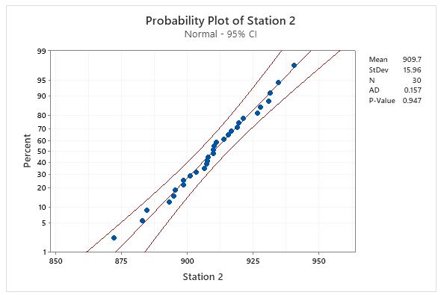
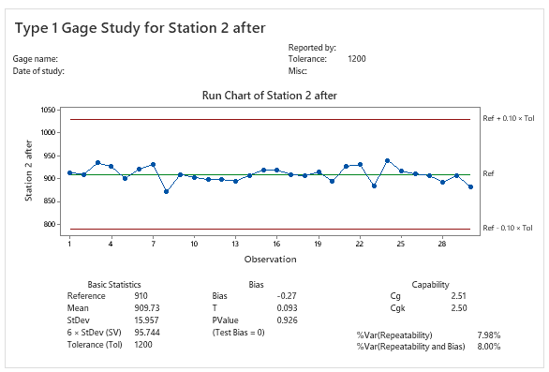
4.2 Type 1 Study again after improvement
Define
Measure
Analyze
Improve
Control
Station 2 Luminance
Use gage study type 1 to assess the ability of component to measure based on repeatability and bias of the instrument after improvement.
In this case, choose 1 sample and repeated test for 30 times.
H0: Bias = 0 in measurement system.
H1: Bias ≠ 0 in measurement system.
No | Luminance(Cd/m²) | No | Luminance(Cd/m²)
1 | 913.97 | 16 | 919.07
2 | 910.09 | 17 | 909.74
3 | 934.62 | 18 | 906.54
4 | 926.63 | 19 | 915.48
5 | 901.07 | 20 | 894.75
6 | 921.35 | 21 | 927.84
7 | 931.37 | 22 | 930.79
8 | 872.12 | 23 | 884.59
9 | 909.81 | 24 | 940.66
10 | 903.27 | 25 | 916.63
11 | 898.65 | 26 | 910.92
12 | 898.47 | 27 | 907.23
13 | 895.41 | 28 | 893.01
14 | 907.88 | 29 | 907.52
15 | 919.56 | 30 | 883.01
Spec: 800.00 ~ 2000.00
Reference value: 910 (golden sample)
Conclusion
P value=0.926 > 0.05 Fail to reject H0 Bias=0 (PASS)
Cg=2.51 (Std>1.33) PASS | Cgk=2.50 (Std>1.33) PASS
%Var(Repeatability)=7.98% (<10%) PASS
%Var(Repeat.+Bias)=8.00% (<10%) PASS
Equipment is OK. LMK camera CS2000 of Station 2 can measure Luminance value.
21 / 33

Slide 22
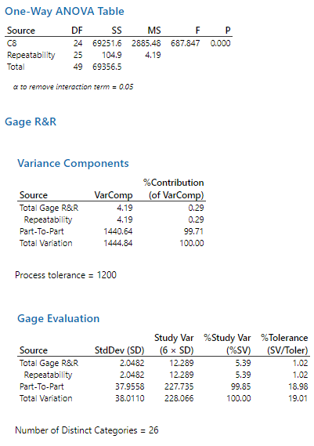
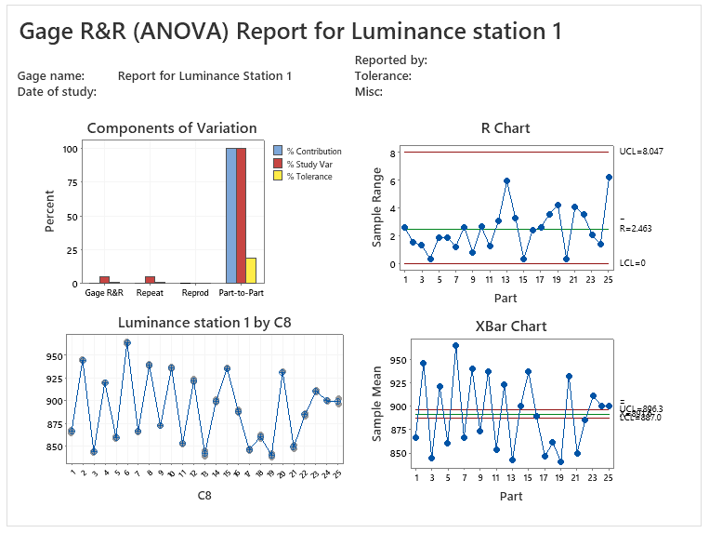
4.2 Check type 3 study again after improvement
Define
Measure
Analyze
Improve
Control
Station 1 Luminance
We only test gage study1, still need to evaluate repeatability and reproducibility at both stations.
Because Luminance stations are fully automated with no operator variation, Type 3 Gage Study is conducted (25 samples measured twice per station).
Use 25 samples measured repeat 2 times to verify each station.
No | Luminance(Cd/m²) | No | Luminance(Cd/m²)
1 | 867.90 | 13 | 839.46
1 | 865.27 | 14 | 901.79
2 | 944.79 | 14 | 898.47
2 | 946.33 | 15 | 936.63
3 | 843.90 | 15 | 936.27
3 | 845.25 | 16 | 890.28
4 | 920.68 | 16 | 887.88
4 | 921.04 | 17 | 845.39
5 | 859.34 | 17 | 848.02
5 | 861.23 | 18 | 862.92
6 | 963.60 | 18 | 859.34
6 | 965.47 | 19 | 838.59
7 | 866.30 | 19 | 842.81
7 | 867.55 | 20 | 932.33
8 | 941.27 | 20 | 931.95
8 | 938.62 | 21 | 847.79
9 | 873.52 | 21 | 851.88
9 | 872.70 | 22 | 886.95
10 | 937.93 | 22 | 883.41
10 | 935.27 | 23 | 910.18
11 | 853.15 | 23 | 912.26
11 | 854.44 | 24 | 901.24
12 | 921.24 | 24 | 899.79
12 | 924.31 | 25 | 903.05
13 | 845.39 | 25 | 896.84
% Contribution of Gage R&R = 0.29 < 10% → OK
% Study Var = 5.39 < 10% → OK
% Tolerance= 1.02 % < 10% → Can use to judge OK/NG
NDC: 26 > 5 → OK
Spec: 800- 2000 (Cd/m²)
Gage R&R conclusion: The measurement system in station 1 is Good
Notes:
Assess variation of each sourse, additional factor afftected to measurement system.
H0: all group mean are equal
H1: not all group mean is equal
VarComp %contribution: almost contribution is from Part to part, the measurement system can reliably distinguish between parts
%Study var: compare the measurement system variation to the total variation
Follow AIAG guidelines, if the measurement system variation is less than 10% of the process variation, then the measurement system is acceptable. Because the %Study Var, the %Tolerance, and the %Process are all less than 10%, the measurement system is Good

Slide 23
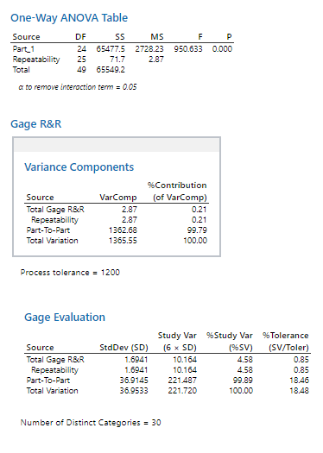
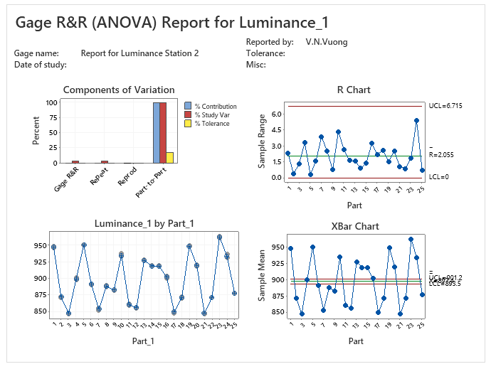
Improve
4.2 Check type 3 study again after improvement
Define
Measure
Analyze
Control
Station 2 Luminance
After adjusting camera angle to 90.0°, Type 3 Gage Study was repeated for Station 2 to verify measurement repeatability.
No | Data | No | Data
1 | 946.86 | 13 | 928.45
1 | 949.24 | 14 | 919.77
2 | 871.49 | 14 | 918.29
2 | 871.89 | 15 | 919.34
3 | 846.49 | 15 | 918.22
3 | 847.85 | 16 | 903.63
4 | 901.35 | 16 | 900.43
4 | 898.05 | 17 | 847.94
5 | 951.03 | 17 | 850.22
5 | 950.78 | 18 | 872.57
6 | 890.56 | 18 | 869.91
6 | 892.16 | 19 | 948.43
7 | 855.23 | 19 | 950.59
7 | 851.36 | 20 | 918.35
8 | 889.44 | 20 | 920.88
8 | 886.99 | 21 | 846.80
9 | 882.94 | 21 | 847.89
9 | 882.16 | 22 | 870.83
10 | 933.20 | 22 | 871.74
10 | 937.61 | 23 | 961.99
11 | 861.69 | 23 | 963.88
11 | 859.00 | 24 | 931.05
12 | 854.84 | 24 | 936.46
12 | 856.49 | 25 | 877.87
13 | 926.83 | 25 | 877.12
% Contribution of Gage R&R = 0.21% < 10% → OK
% Study Var = 4.58% < 10% → OK
% Tolerance= 0.85 % < 10% → Can use to judge OK/NG
NDC: 30 > 5 → OK
Conclusion : Measurement system of station 2 is Good after improving measurement system
Notes:
Assess variation of each sourse, additional factor afftected to measurement system.
H0: all group mean are equal
H1: not all group mean is equal
VarComp %contribution: almost contribution is from Part to part, the measurement system can reliably distinguish between parts
%Study var: compare the measurement system variation to the total variation
Follow AIAG guidelines, if the measurement system variation is less than 10% of the process variation, then the measurement system is acceptable. Because the %Study Var, the %Tolerance, and the %Process are all less than 10%, the measurement system is Good

Slide 24
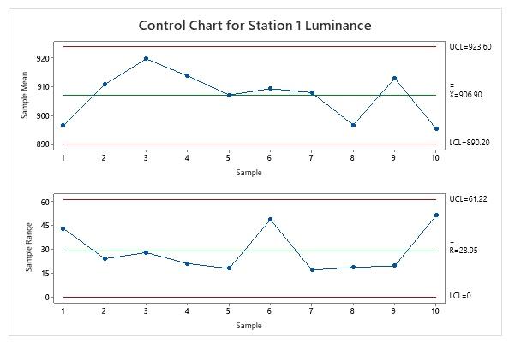
D
I
C
M
A
4.3 Xbar-R Chart Review after improving the measurement system
Define
Measure
Analyze
Improve
Control
Station 1 Luminance
To monitor the mean and the variation of process after applying improvement and use control chart to monitor process stability over time.
- Sampling method: Rational sub group sampling first 5ea/day at production line for 10 days to analyze:
Date | Sample 1 | Sample 2 | Sample 3 | Sample 4 | Sample 5
1-Jul | 879.90 | 878.25 | 891.17 | 921.47 | 911.97
2-Jul | 918.79 | 908.47 | 897.79 | 906.27 | 921.88
3-Jul | 920.61 | 929.42 | 914.50 | 930.37 | 902.39
4-Jul | 913.69 | 907.88 | 921.66 | 901.92 | 922.89
5-Jul | 901.04 | 902.26 | 916.63 | 898.68 | 916.27
6-Jul | 903.05 | 920.08 | 880.62 | 929.37 | 912.76
7-Jul | 911.27 | 914.57 | 897.62 | 907.43 | 907.96
8-Jul | 892.92 | 896.84 | 890.74 | 893.58 | 909.34
9-Jul | 919.62 | 915.27 | 905.33 | 921.51 | 901.95
10-Jul | 893.52 | 888.02 | 875.39 | 893.15 | 926.85
Conclusion:
No abnormality can be found in the Xbar control chart and the R control chart. Therefore, stability is acceptable, the performance of process over time is Good
Notes:
Examine the R chart to determine whether the process variation is in control
Examine the Xbar chart to determine whether the process mean is in control

Slide 25
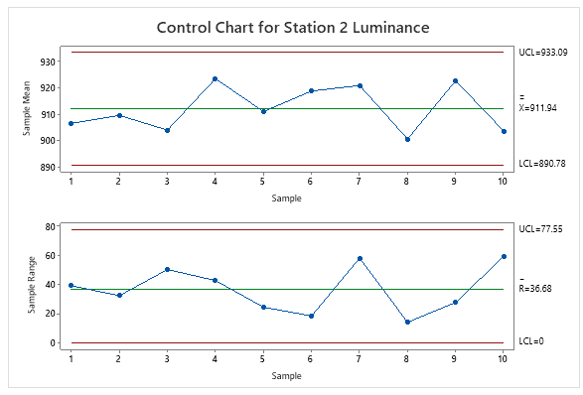
D
I
C
M
A
4.3 Xbar-R Chart Review after improving the measurement system
Improve
Define
Measure
Analyze
Control
Station 2 Luminance
To monitor the mean and the variation of process after applying improvement and use control chart to monitor process stability over time.
- Sampling method: Rational sub group sampling first 5ea/day at production line for 10 days to analyze:
Date | Sample 1 | Sample 2 | Sample 3 | Sample 4 | Sample 5
1-Jul | 903.99 | 888.65 | 927.84 | 910.28 | 901.09
2-Jul | 910.09 | 898.47 | 930.79 | 906.56 | 901.04
3-Jul | 934.62 | 905.74 | 884.21 | 897.26 | 897.52
4-Jul | 926.69 | 897.88 | 940.66 | 917.92 | 932.89
5-Jul | 901.07 | 919.56 | 916.63 | 920.68 | 896.27
6-Jul | 921.35 | 919.07 | 910.92 | 929.27 | 912.16
7-Jul | 931.37 | 899.74 | 907.23 | 957.93 | 907.04
8-Jul | 902.12 | 906.54 | 893.01 | 893.85 | 907.01
9-Jul | 909.81 | 925.48 | 937.52 | 920.73 | 918.64
10-Jul | 893.27 | 904.75 | 873.01 | 914.26 | 932.42
Conclusion:
No abnormality can be found in the Xbar control chart and the R control chart. Therefore, stability is acceptable, the performance of process over time is Good

Slide 26
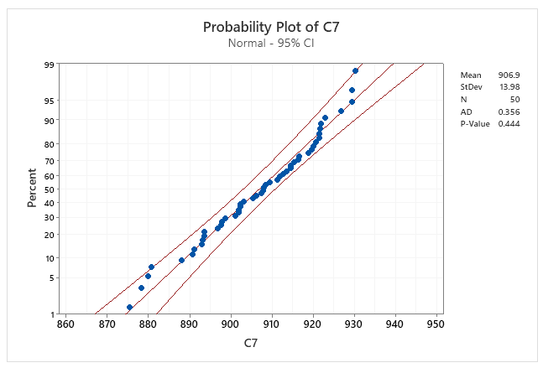
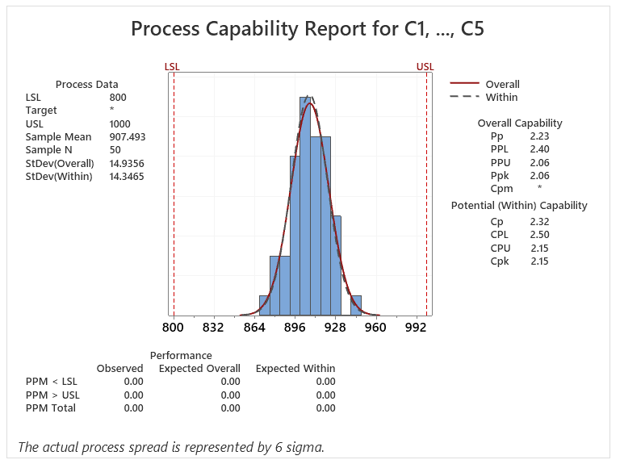
D
I
C
M
A
4.4 Check Process Capability after improving the measurement system
Improve
Define
Measure
Analyze
Control
Station 1 Luminance
Use Normality test to determine whether the data do not follow the distribution
H0: Data follows Normal Distribution
H1: Data does NOT follow Normal Distribution
P-value = 0.444 > 0.05 -> Fail to reject H0 -> Data follows Normal Distribution (PASS)
Then, check the points if it fit the distribution lines more closely to the fitted distribution, the more good the data.
After that, evaluate process capability:
P-Value = 0.444 > 0.05 → Pass
(It has a normal distribution)
Cpk = 2.15 (Standard ≥ 1.67) → Process capability is sufficient.
Focus effort on maintenance and shared management measures
Notes:
--To evaluate process capability:
Check the data fit the distribution
Notice if the solid curve fit closely the dash curve
Evaluate the capability base on performance and the Potential capability indicate, compare Cpk with a benchmark value that is acceptable for the process
Dash: within curve
Solid: overall curve

Slide 27
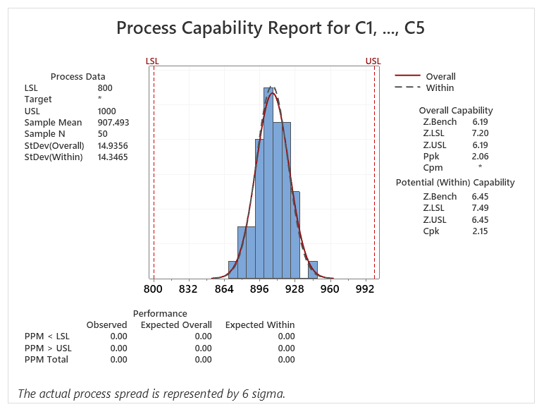
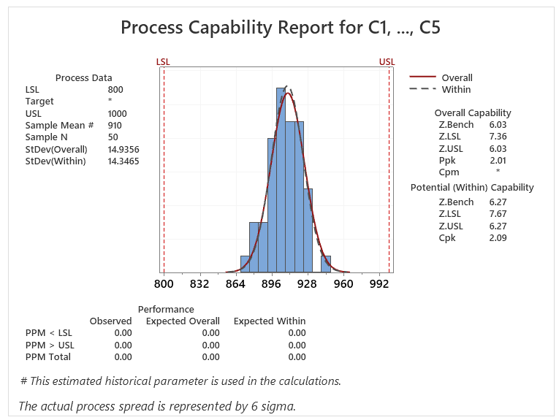
4.4 Check Process Capability after improving the measurement system
Improve
Define
Measure
Analyze
Control
Station 1 Luminance
Z Long term = 6.19 Standard ≥ 4.5
→ OK
Z Short term = 6.27 Standard ≥ 6
→ OK
Z _{shift}
Check the Z short term (best capability of process) and the Z long term (customer’s perspective):
Zshift = Zst – Zlt = 6.27 – 6.19= 0.08 → Z shift < 1.5
→ Proper process control management
Z long term : 6.19 ≥ 4.5, Z short term: 6.27 ≥6
→ Technology is OK
Lack of management
Lack of skill
Lack of management
Proper skills
A
B
1.5
Control
C
D
Proper management
Lack of skills
Proper management
Proper skills
4.5
Z_{ST} Or Z_{ST}(Bench)
Poor
Technology
Good
Notes:
Zst: within (historical mean), Zlt: overall. The short-term process capability (Zst) represents the best capability of the current process. (Zlt) represents the process capability of the customer's perspective.
In the early days of development, when the current capability is considered to be the best, the quality will deteriorate due to wear of tool and equipment, variation of worker, change of environment as time flows. Indicating a degree of deterioration, and a value of 1.0 to 1.5 is deteriorated based on the Z value. Management is not good if Zshift amount is greater than 1.5 and Zshift amount is less than 1.5, judged management is good
Cpk is a measure of the potential capability of the process and equals the minimum of CPU and CPL. Cpk is a ratio that compares two values:
The distance from the process mean to the closest specification limit (USL or LSL)
The one-sided spread of the process (the 3-σ variation) based on the within-subgroup standard deviation
Cpk considers both the location and the variation (within subgroups) of the process.

Slide 28
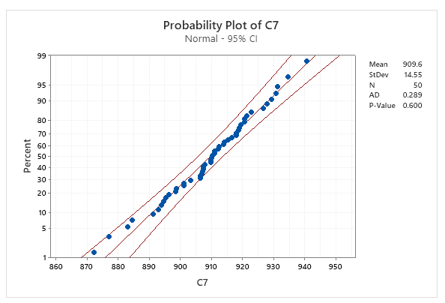
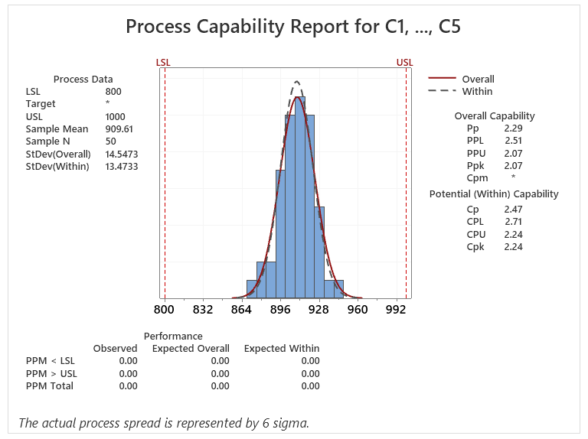
D
I
C
M
A
4.4 Check Process Capability after improving the measurement system
Improve
Define
Measure
Analyze
Control
Station 2 Luminance
To evaluate process capability of station 2:
P-value = 0.600 > 0.05 -> Fail to reject H0 -> Data follows Normal Distribution (PASS)
(It has a normal distribution)
Cpk = 2.24 (Standard ≥ 1.67) → Pass

Slide 29
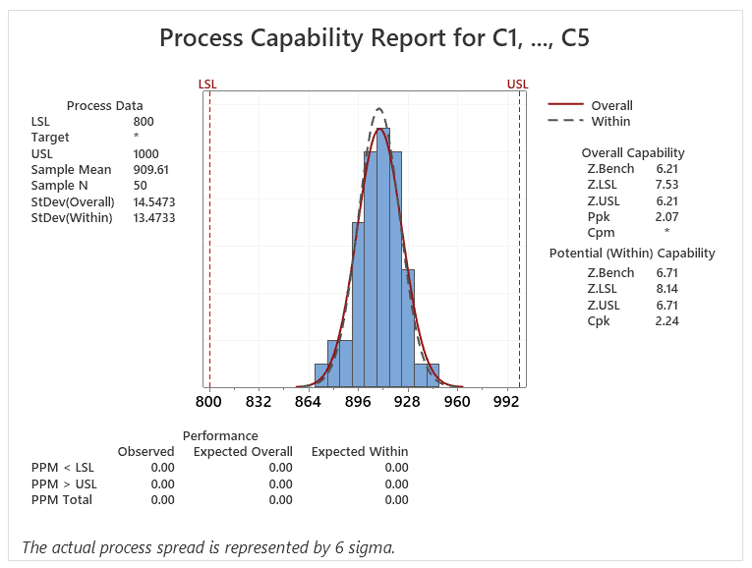
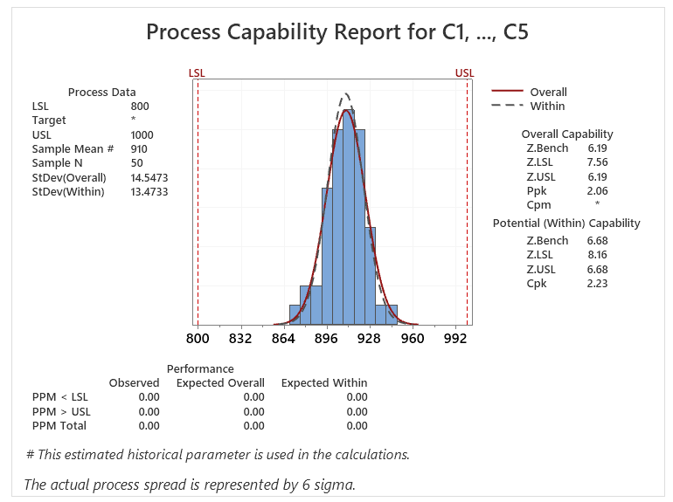
D
I
C
M
A
4.4 Check Process Capability after improving the measurement system
Improve
Define
Measure
Analyze
Control
Station 2 Luminance
Z Long term = 6.21
Standard ≥ 4.5
→ OK
Z Short term = 6.68 Standard ≥ 6
→ OK
Z _{shift}
Lack of management
Lack of skill
Lack of management
Proper skills
Zshift = Zst – Zlt = 6.68 – 6.21= 0.47 → Z shift < 1.5
→ Proper process control management
Z short term: 6.68 ≥ 6 , Z long term: 6.21 ≥ 4.5
→ Technology is OK
A
B
1.5
Control
C
D
Proper management
Lack of skills
Proper management
Proper skills
4.5
Z_{ST} Or Z_{ST}(Bench)
Poor
Technology
Good
Notes:
Zst: within (historical mean), Zlt: overall. The short-term process capability (Zst) represents the best capability of the current process. (Zlt) represents the process capability of the customer's perspective.
In the early days of development, when the current capability is considered to be the best, the quality will deteriorate due to wear of tool and equipment, variation of worker, change of environment as time flows. Indicating a degree of deterioration, and a value of 1.0 to 1.5 is deteriorated based on the Z value. Management is not good if Zshift amount is greater than 1.5 and Zshift amount is less than 1.5, judged management is good
Cpk is a measure of the potential capability of the process and equals the minimum of CPU and CPL. Cpk is a ratio that compares two values:
The distance from the process mean to the closest specification limit (USL or LSL)
The one-sided spread of the process (the 3-σ variation) based on the within-subgroup standard deviation
Cpk considers both the location and the variation (within subgroups) of the process.

Slide 30
4.5 Conclusion
Define
Measure
Analyze
Improve
Control
After evaluation, we confirmed that the measurement system at Station 2 had significant problems during testing (while Station 1 was normal). We proved that camera angle misalignment was the root cause of the Luminance NG defect.
We improved the measurement system by correcting the camera angle to 90.0°. We then verified stability and capability using Type 1 Study, Type 3 Gage R&R, Xbar-R control charts, and Process Capability analysis for both stations.
The results demonstrate that both measurement stations achieve high repeatability, zero bias, and excellent process capability (Cpk > 2.0).

Slide 31
5.1 Result of project
Define
Measure
Analyze
Improve
Control
Summary Defect rate of J1 model after improvement
 | Before |  |  |  | After
Date | 16.Nov.2023 | 2.Jan.2024 | 23.Feb.2024 | 1.Mar.2024 | 15.Sep.2024 | 21.Nov.2024 | 28.Feb.2025
Total NG | 13 | 8 | 92 | 30 | 0 | 0 | 0
Prod Q'ty | 200 | 120 | 240 | 71 | 240 | 120 | 60
Defect rate (ppm) | 65000 | 66666.67 | 383333.33 | 422535.21 | 0 | 0 | 0

Slide 32

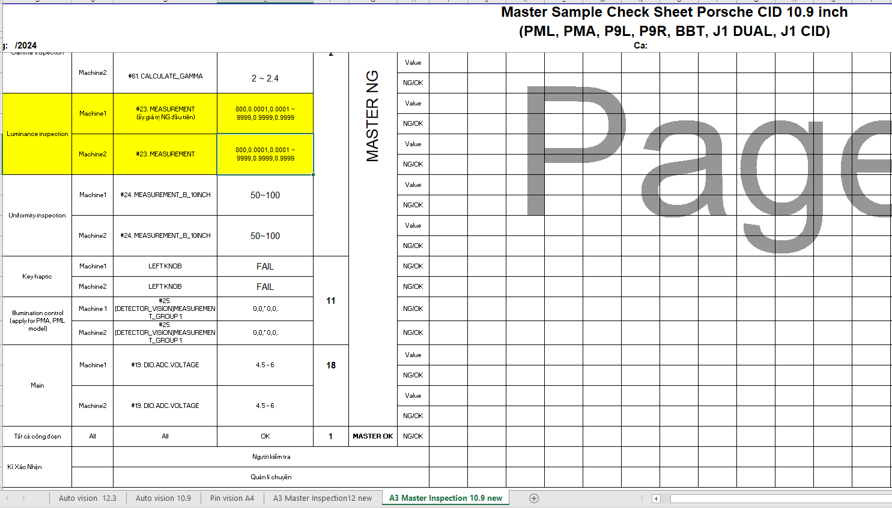

5.2 Future plan
Define
Measure
Analyze
Improve
Control
Management plan
Make checksheet to control equipment with master sample
Actual DID check sheet in production line
DID check sheet format
A daily check sheet is established to monitor equipment status using a Master sample. Because the J1 Dual model features dual displays requiring camera movement, camera angle status must be verified during pre-production setup to prevent angle deviation.

Slide 33
5.2 Future plan
Define
Measure
Analyze
Improve
Control
Management plan
Master Sample Management Procedure:
• Inspection Timing: Daily before shift start (08:00~10:00 AM for day shift, 20:00~22:00 PM for night shift).
• Responsible: PM Technician & Line Leader.
• Procedure:
1. Test Master Sample at Luminance station and verify values are within spec (800~2000 Cd/m²).
2. If any abnormal reading is detected, report immediately to Line Leader; PE & PM teams will inspect camera alignment.
3. GMES version checking (SW/HW) is skipped during Master Sample testing to focus strictly on hardware measurement stability.

